Slide 1
DATA STORYTELLING
BY
BASIRA ESAN
[FE/23/8059291]

Slide 2
INTRODUCTION
Dream housing finance company deals in all home loans. They have a presence across all urban and semi-urban and rural areas.
The company wants to automate the loan eligibility process(real time) base on customer details provided while filling the online application form

Slide 3
AIMS AND OBJECTIVES
Is to identify the customer’s segments those eligible for loan amount so that they can specifically target these customers to provide them with autometed loan amount

Slide 4
METHODOLOGY
The data was collected from the list of customers who have a record of applying for loan from the bank for a specific period of time.

Slide 5
KEY QUESTIONS
Which gender fill’s loan application form most?
Which occupation takes loan more often?
At what basis should loan be granted?

Slide 6
FINDINGS AND INSIGHTS

Slide 7
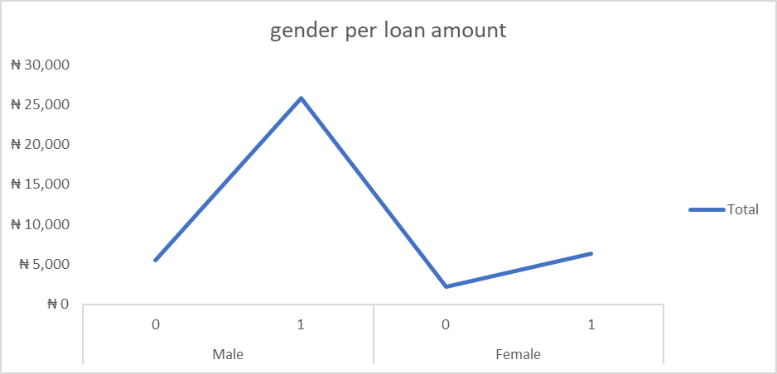
Which gender fill’s loan application form most?
From the analysis made it is found that the male gender fill’s loan application more often due to demand in expenditure but looking at the data you will discover that the female application is beginning to rise with some active loans unpaid

Slide 8
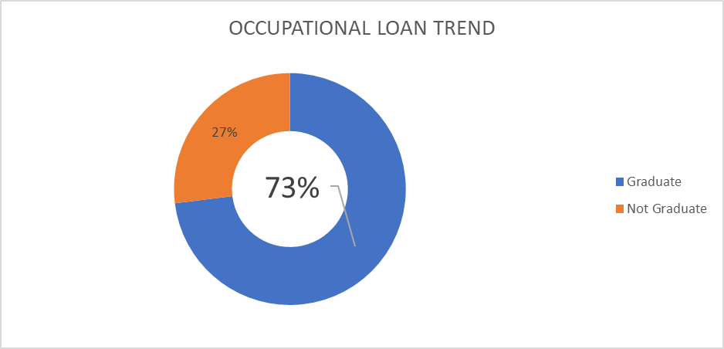
Which occupation takes loan more often?
It is discovered that in real time the graduate has about 73% loan application than the non graduate category. This means there is low tendency of non graduate filling loan forms as most of what they may need is provided for by parents or guardian.

Slide 9
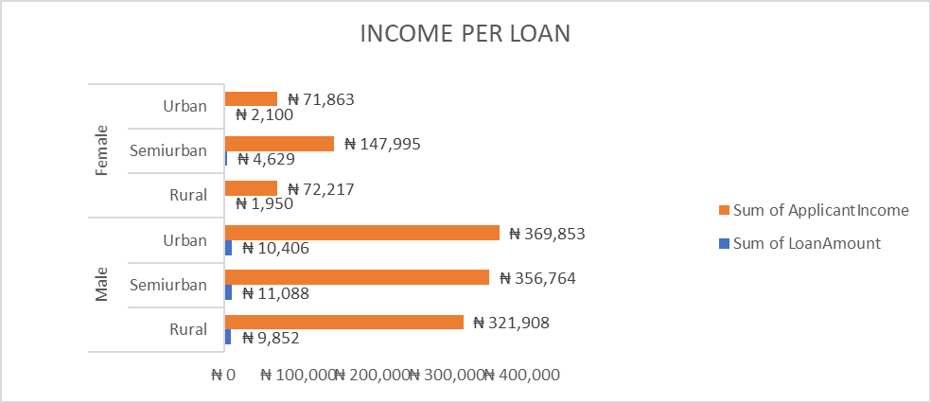
At what basis should loan be granted?
This analysis shows the basis of loan automation. Looking at the chart it shows that male in the urban region has the highest income which tells us that the residents of urban region should get higher loan amount when the form is filled online, followed by sub urban

Slide 10
Recommendation and conclusion
Given the analysis its recommended that the loan application automation should be base on salary income and region which is that, if you have a higher salary income coming into your account and you also reside in the urban part of the country, checking these two strong criteria when you fill an online loan form it should automatically offers you a higher amount than does people staying in sub urban and has low salary income
In conclusion this automatically gives the bank an edge because loan will be automatically deducted and loan defaulters will no longer have reasons as to why they don’t pay loan on time. This saves the bank some stress and also help the bank recover given loans at the appropriate time.

